Slide 1

Building C# Analyzers and Quick Fixes with "Roslyn"
Kevin Pilch
Principal Software Engineering Manager
Microsoft

Slide 2
What is a Code Aware Framework?
A library that provides guidance on correct use through embedded tooling and operates on the user’s code in real-time.

Slide 3
Examples – Stringly typed APIs
if (argument == null)
{
throw new ArgumentNullException("argument");
}
[HttpGet]
public ActionResult Index()
{
return View("Index");
}

Slide 4
Examples – in Roslyn
API design guidelines:
CancellationToken rules
API usage concerns:
MEF v1 vs MEF v2, using ConfigureAwait
Performance concerns:
Unnecessary allocations, slow Linq calls
Recently added a “Meta-Diagnostics” package
Forgotten attributes, invalid arguments

Slide 5
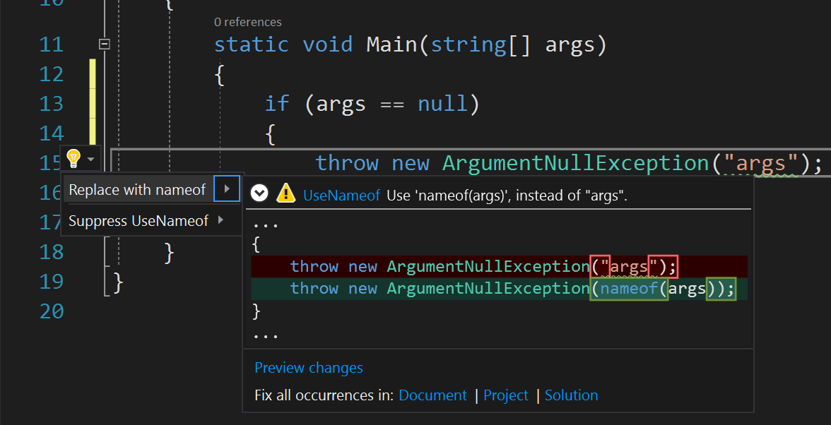
Today – Using “nameof”

Slide 6
Building an Analyzer

Slide 7
Syntax Tree API – Nodes
class C
{
void M()
{
}
}// C
▫
CompilationUnit
ClassDeclaration
MethodDeclaration
ParameterList
Block
var tree = CSharpSyntaxTree.ParseText("...");

Slide 8
Syntax Tree API – Tokens
class C
{
void M()
{
}
}// C
▫
CompilationUnit
ClassDeclaration
EOF
class
C
{
MethodDeclaration
}
void
M
ParameterList
Block
(
)
{
}

Slide 9
Syntax Tree API – “Trivia”
class∙C↵
{↵
∙∙∙∙void∙M()↵
∙∙∙∙{↵
∙∙∙∙}↵
}// C↵
▫
CompilationUnit
ClassDeclaration
EOF
class
SP
C
EOL
{
EOL
MethodDeclaration
}
// C
EOL
SPx4
void
SP
M
ParameterList
Block
(
)
EOL
SPx4
{
EOL
SPx4
}
EOL

Slide 10
Syntax Tree API
class C
{
void M()
{
}
}// C
▫
CompilationUnit
ClassDeclaration
EOF
class
C
{
MethodDeclaration
}
void
M
ParameterList
Block
(
)
{
}

Slide 11
Adding a fix

Slide 12
Syntax Tree API
CompilationUnit
class C
{
void M(int x)
{
}
}// C
▫
ClassDeclaration
EOF
class
C
{
MethodDeclaration
}
void
M
ParameterList
Block
(
)
{
}
var oldList = method.ParameterList;
var newList = oldList.WithParameters(
parameters: SyntaxFactory.ParseParameterList("(int x)").Parameters);
var newRoot = tree.GetRoot().ReplaceNode(oldList, newList);

Slide 13
Syntax Tree API
CompilationUnit
class C
{
void M(int x)
{
}
}// C
▫
ClassDeclaration
EOF
class
C
{
MethodDeclaration
}
void
M
ParameterList
Block
(
Parameter
)
{
}
PredefinedType
x
var oldList = method.ParameterList;
var newList = oldList.WithParameters(
parameters: SyntaxFactory.ParseParameterList("(int x)").Parameters);
var newRoot = tree.GetRoot().ReplaceNode(oldList, newList);
int

Slide 14
Syntax Tree API
CompilationUnit
class C
{
void M(int x)
{
}
}// C
▫
ClassDeclaration
EOF
class
C
{
MethodDeclaration
}
void
M
ParameterList
Block
(
Parameter
)
{
}
PredefinedType
x
var oldList = method.ParameterList;
var newList = oldList.WithParameters(
parameters: SyntaxFactory.ParseParameterList("(int x)").Parameters);
var newRoot = tree.GetRoot().ReplaceNode(oldList, newList);
int

Slide 15
Symbols versus Syntax
Symbol
If you’re operating outside a method body
Language agnostic
Easy to check accessibility, attributes, and other aspects at the member signature level
Syntax
If you’re operating inside a method body
Language specific
Full fidelity access to the code

Slide 16
Kinds of diagnostic analyzers
RegisterSyntaxNodeAction | Triggered when a particular kind of syntax node has been parsed
RegisterSymbolAction | Triggered when a particular kind of symbol has been analyzed
RegisterSyntaxTreeAction | Triggered when the file’s whole syntax tree has been parsed
RegisterSemanticModelAction | Triggered when a semantic model is available for the whole file
RegisterCodeBlock(Start)Action | Triggered before/after analysis of a method body or other code block
RegisterCompilation(Start)Action | Triggered before/after analysis of the entire project
Top-level analyzers you create must be stateless - VS will reuse them
Register…StartAction methods let you spawn a one-time nested analysis pass, useful when you do need to accumulate state

Slide 17
Advanced
Custom presentation in VS
Fixes that need input and display dialogs
Contribute to Completion Lists

Slide 18
What can you build?

Slide 19
Resources
http://roslyn.io
http://source.roslyn.io
https://gitter.im/dotnet/roslyn
http://twitter.com/roslyn
http://stackoverflow.com/questions/tagged/roslyn

Slide 20
Kevin Pilch
kevinpi@microsoft.com
@Pilchie
http://roslyn.io

